Slide 1

Child guard system
Advanced SE class team project, team 4
Sunzu Kim, Jaehwan Lee, Šimon Hrabec
Notes:
Good afternoon, it is an honor for us to present you our project, which is called “Child guard system”.

Slide 2

Content
Introduction - Motivation & Background - Problem statement
Solution(propose) - Approach the idea - Objective - Solution
Requirement - Use case - Goal-based modeling
System introduction - Design & architecture - Technology used
Testing - Testing Strategy
Demo
Conclusion
Notes:
In the beginning, we would like to tell you why this topic matters and why we chose it. Then we will explain you how our system might help and we will also discuss what technologies we have used and what is the architecture. At the end we will show you short demo as a demonstration.

Slide 3
Motivation & Background
Motivation & Background
Elementary school cannot stay long enough for the parent to finish his work.
In 43.5 % of families having an elementary school child both parents are working, making it up to 1.38 million families in total.
One million elementary school students are left alone to go back home without an adult who can protect them.
Notes:
In Korea nowadays due to the harsh working culture (considering working long hours as a must) families with children, where both parents work, are experiencing a serious troubles related to children. Since the children is small and cannot fully take care of itself some supervision/babysitting is required.
At the age of 8 children go to school.

Slide 4
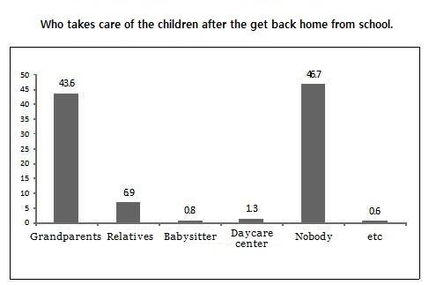
Motivation & Background(cont.)
During their way back home are exposed to some threads.
they stay home alone for a long time and exposed to TV and computer – using these without any restrictions.
Notes:
Still, in many cases, there is no one to keep eye on children. These children are exposed to various threads, which every parents would like to avoid. Being aware of this situations happening might also discourage couples to have children, lowering already extremely low fertility rate (one of the smallest in the world, causing a future demographic issue of lack of people in productive age).
The problem is that not all parents have enough resources to pay for the academy in order to solve the issue.

Slide 5
Problem statement
Problem
To overcome loneliness, they watch TV and Computer but they are exposed for too long.
Parents and children don't have enough time to communicate which leads to emotional suffering.
Because of the absence of parents the children may freely go outside which expose the children to risk of violence.

Slide 6
Objective
First objectives is to keep safe the children who stay home alone before parents come home.
Second objectives is to check dangerous threats.
The most important goal is to improve the ability of self-control and discipline of the children through constraints and rewards.
Notes:
Facing this situation we came up with an idea that could help to this group of people. We made a system consisting of home IoT based part and mobile application, that helps parents to keep track of their loved ones (children), knowing whether they are safe at home and what are they doing.

Slide 7
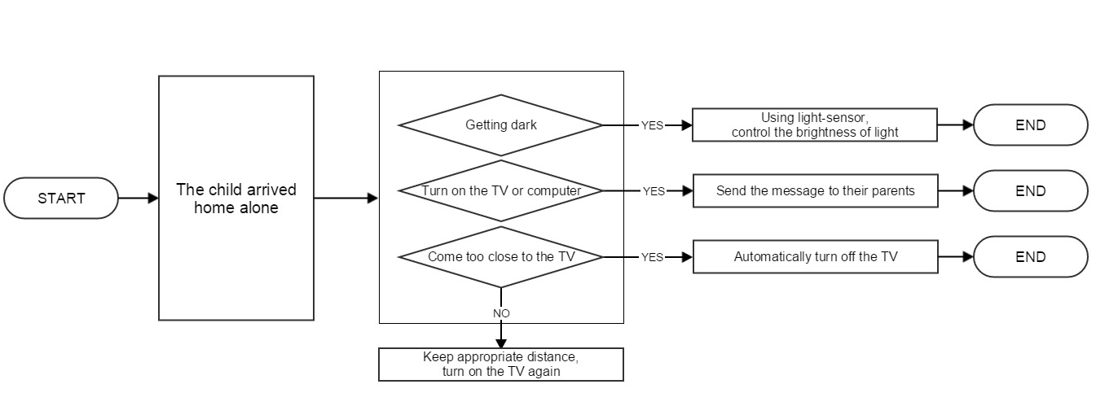
Solution
Proposed idea
When the child is home alone, we will automatically inform the parents about the activities the child do.
Notes:
a. When the child comes home and turn on the Television and computer, send the message to their parents such as "came home"," watching TV" or "playing computer". Therefore, the parents can know what the child is doing
b. Control the light in the room according to set needs, avoiding direct sunlight to child, matching the amount of light to his day-cycle.
c. It is not good for their eyesight to watch the TV from close distance. When the child comes too close to the TV, the TV turn off automatically. If the child restore the distance, turn the TV back on.

Slide 8
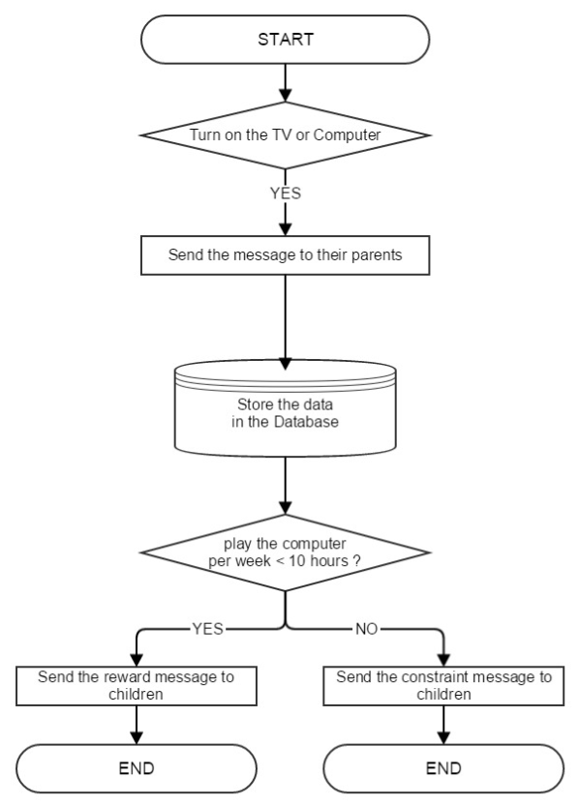
Solution(cont.)
When the child watches the television and plays the computer, we automatically collect the data of using hours and save that to the Database table.
After analyzing the data, if the child watch the television appropriately, they could get some reward from the parents.
Notes:
d. When the child watches the television and plays the computer, we automatically collect the data of using hours and save that to the Database table. After analyzing the data, if the child watch the television appropriately, they could get some reward from the parents. For example, if the child play the computer less than 10 hours per week, the message would be sent their parents so that could be induced to give some compensation to the child.

Slide 9
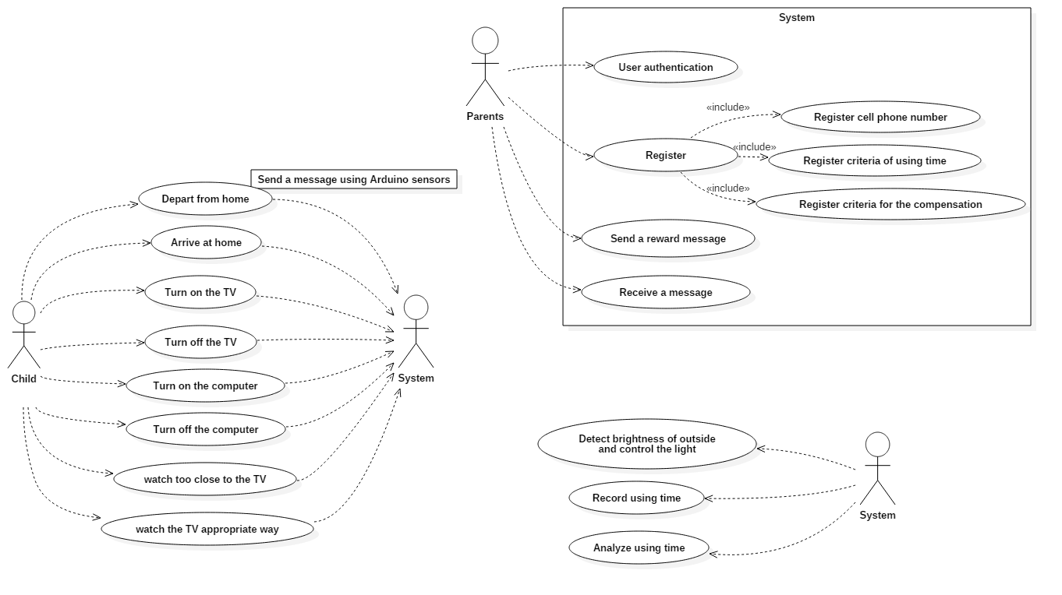
Requirement – use case
Notes:
Parents which represent an actor that can register information into the system, Child which represents an actor that has stayed alone at home safely and System which represents an actor that can automatically control the house and store the data into the system. Parents can register the criteria of using time, compensations, send a message to their children and receive some message from the system.
By selecting to register option in case of parents, parents will be shown menu options of to enter a cell phone number, criteria of using time and criteria the compensations. Registering or removing the information can be possible.

Slide 10
Requirement(cont.)
Customer Requirements
 | Description
1. | Inform parents about arrival/departure of child to home
2. | Control light in the room where the child is
3. | Measure child‘s distance from TV, turning it on/off
4. | Record the time child spends using computer
5. | Store/view measured data, including using time of device
6. | Offer a child compensation for given task/criteria
7. | Log in on Tizen phone using credentials
8. | Provide a mobile application to access the functions

Slide 11
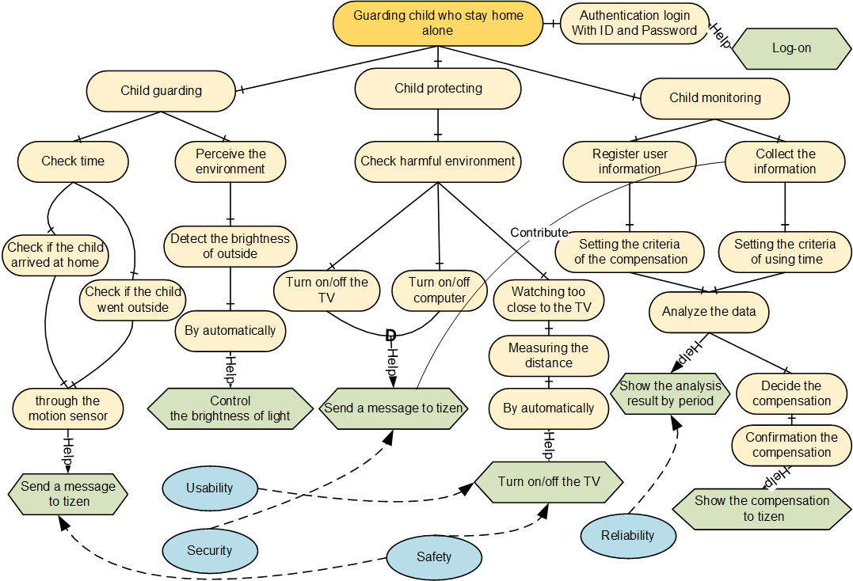
Goal-based modeling

Slide 12
Functional requirement
Features | Description
User login | Login state
 | Parents can quickly and safely login using the system authentication within registered member.
Confirmation child | Confirms child state
 | When child comes home, it sends a message to his/her parents.
Control the brightness of light | Controls the light state
 | Controls the light in the room according to set needs, avoiding direct sunlight to the child.
Checking operation of electronics | Checks the electronics state
 | If child uses the TV or computer, it automatically checks the devices and sends a message.
Automatically turn on/off the TV | Measures the distance
 | When the child comes too close to the TV, the TV automatically turns off. If the child restore the distance, turn the TV turns back on
Register user information | Input user information state
 | Information about child or parents’ phone number. Input some of compensation.
Monitoring | Monitors the information state
 | Parents confirm the time a child used the computer or TV for a week.
Notes:
??

Slide 13
Non-functional requirement
Interface
The Interface shall contain menus where parents can enter the information.
Physical
The systems requires network connection in order to serve its functions
Design
The application will be done as a mobile application.
Implementation
The system shall use Tizen operating system.
The system shall use Arduino uno which is based on a C-like programming language
Organization
The system shall be designed using Tizen application program.
Design and modeling of the system shall utilize UML (Unified Modeling Language).
Accessibility
The interface shall be usable and easily accessible by parents who are not familiar with smartphones.
The interface shall use an adequate font size to be usable by persons with limited visual acuity.
Security
The system will not violate any legislation.
The system will only allow validated, authenticated parents to access not the child.
Accuracy
The system shall provide child’s exact arrival/departure time information to the parents – with accuracy of seconds.
Efficiency
The system shall be possible to use everywhere to check the data.
Response
The system responses shall occur within 30 seconds.
The user’s requirements shall be adjusted immediately.
Reliability
The system will allow nobody except the parents to access the data.
Robustness
The system should gracefully handle invalid input (e.g. incorrect input number, name, etc.)
Safety
The system shall not accidentally lose any data including phone numbers and the recorded child behavior.
Usability
The system shall be easy to access the application.
The system shall revise the information (e.g. changing cell phone number, compensations and the criteria of using time)
The system shall be activated automatically.
Notes:
??

Slide 14







Design & Architecture
Interact
Send data
Monitor
Store data
Notes:
Architecture of our system is following. Arduino at home monitors children, sends information to server which stores the incoming data in database and also interact with parents trough the mobile application.

Slide 15

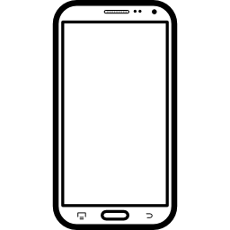




Design & Architecture
Technology used
Home
Web server
Client(Jquery mobile)
Sensors
Notes:
For the purpose of our project we’ve decided to use these technologies. Arduino micro controllel for managing sensors at home, Python and php for web server (using MySQL database for data storage) and tizen based smartphone for mobile application.

Slide 16
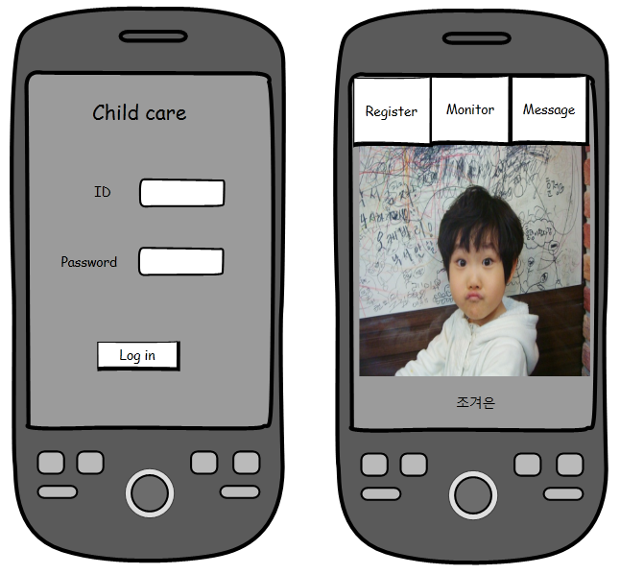
Design & Architecture (cont.)
Design UI
The first screen allow user to log in to his account which is paired to his children.
From the second screen it is possible to reach most of the application functionality.
Notes:
The first screen allow user to log in to his account which is paired to his children. From the second screen it is possible to reach most of the application functionality.

Slide 17
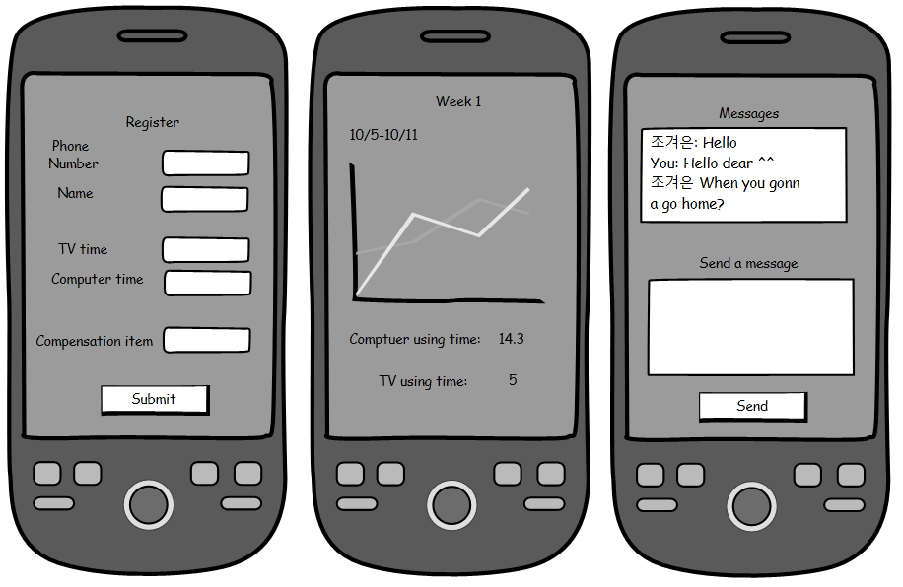
Design & Architecture (cont.)
Design UI
Register information - his phone number, criteria for watching TV and using computer
The monitoring function – shows information on a week basis, including a graph drawing a cumulated time over the week.
Message screen - shows messages sent between the parent and the child and allow then to communicate.
Notes:
The following screen allow user to register information - his phone number, criteria for watching TV and using computer
The monitoring function shows information on a week basis, including a graph drawing a cumulated time over the week.
Message screen shows messages sent between the parent and the child and allow then to communicate.

Slide 18
1. Testing strategy - Unit Test - Unit test system was conducted divided into two parts. - The two parts are part of the Arduino application Tizen only part of the client, as shown below. Then, proceed to the test for each unit.
Testing
Subsystem | Category | Work scope | Unit test-ID | Unit test-Name
Child-Guard system | Arduino Uno TEST | Detection sensor and output sensor value | 1 | The child has come to the home alone.
 |  |  | 2 | The outside has become dark.
 |  |  | 3 | Turn on the television/computer
 |  |  | 4 | Too close to watch the television.
 |  |  | 5
 | Tizen TEST | Login | 1 | Registration basic child/parents information
 |  | Registration Basic information | 2 | Registration reasonable using the television/computer time
 |  |  | 3 | Registration compensation items
 |  | Monitoring | 4 | View the monitoring screen
 |  | Compensation | 5 | Send the compensation message
Notes:
??

Slide 19
Testing 2. Testing Strategy - Integrating Testing - Integration testing is to test the following matter how Arduino sensor values are correctly linked to the application of Tizen. - If the Arduino sensor values is detected, whether Tizen apps in real-time transmission of the message screen. - Through the monitoring screen of the app, for a week with shows by comparison the TV / computer time and registered with a reasonable time period. - If you press the button, compensation, rewards information is sent cell phone text as a child.
Notes:
??

Slide 20
1. Light on / off 2. Television turn on / off 3. Too close to watch the television(Automatically turn off) 4. Tizen application system
Demonstration
Notes:
??

Slide 21
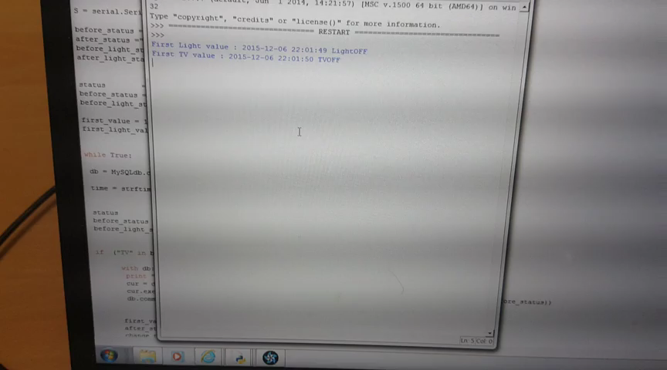
Demo – 1. Light on/off
Light on/off
Notes:
In order to provide you with deeper insight into our project lets watch a short video. People say that one picture is worth a thousand words, since there is a lot of pictures in this video we might save a lot of time of talking. (((wait until they start to laugh, otherwise say after few seconds it was a joke, supposed to be funny)))

Slide 22
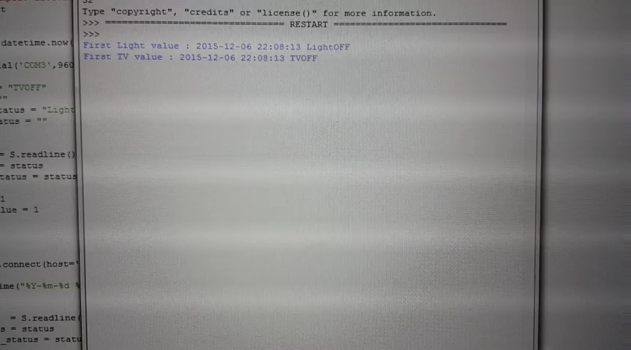
Demo – 2. TV on/off
Light on/off
Notes:
In order to provide you with deeper insight into our project lets watch a short video. People say that one picture is worth a thousand words, since there is a lot of pictures in this video we might save a lot of time of talking. (((wait until they start to laugh, otherwise say after few seconds it was a joke, supposed to be funny)))

Slide 23
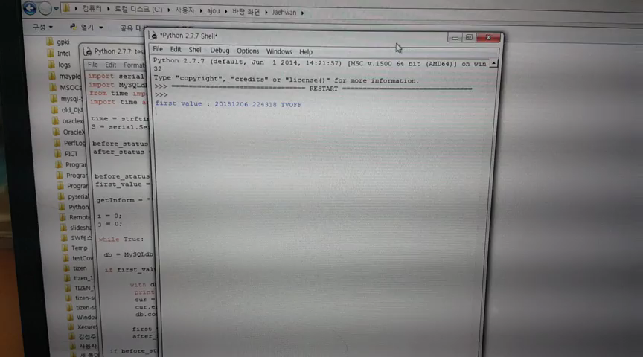
Demo – 3. Too close to watch TV
Light on/off
Notes:
In order to provide you with deeper insight into our project lets watch a short video. People say that one picture is worth a thousand words, since there is a lot of pictures in this video we might save a lot of time of talking. (((wait until they start to laugh, otherwise say after few seconds it was a joke, supposed to be funny)))

Slide 24
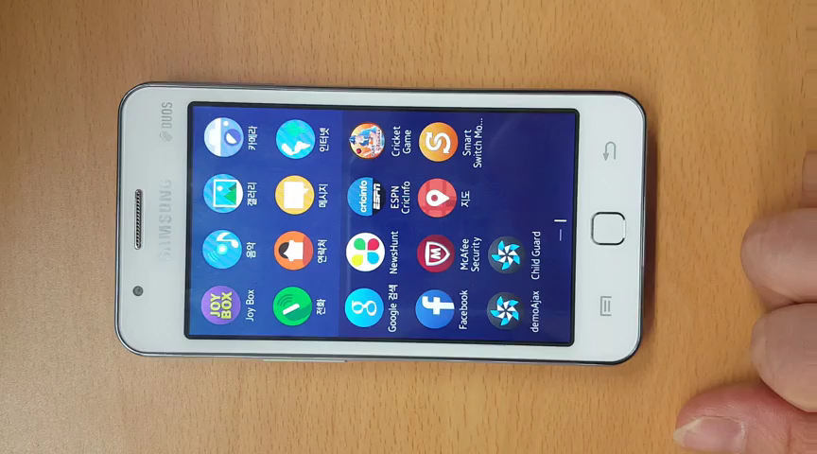
Demo – 4. Tizen application
Notes:
In order to provide you with deeper insight into our project lets watch a short video. People say that one picture is worth a thousand words, since there is a lot of pictures in this video we might save a lot of time of talking. (((wait until they start to laugh, otherwise say after few seconds it was a joke, supposed to be funny)))

Slide 25
Lesson’s learn.
Process
SE process
Project analysis and architecture
IoT principles
Technic
Device – Arduino UNO
Programming languges (Java, Python)
UML diagrams
Project management
Team communication
Crisis management (deadlines)
Notes:
We came in touch with many things in this class during this semester and we have learnt a lot of things. IoT was a thing we heard about, but we have not come in touch with that yet, therefore we appreciate getting some experience about it.
Also as we came trough our project we had to implement some things using different programming languages.
During the semester we were learning about the importance of SE process and methods.
Also this was a team project, therefore we had to communicate with each other using English, experiencing different approaches based on our different cultural background.

Slide 26
Summary
By this project we want to achieve several things:
Support safety of children
Enable parents to work without worrying
Notes:
We hope our idea is worth the attention and that our project might actually be helpful.

Slide 27
Questions
Thank you for listening.
Feel free to ask questions.

